Slide 1


Programming with Python
and Bananas
Ron Greeff

Slide 2

Python is a general purpose programming language
Great language to learn programming!
Web Development - Django, Flask
Machine learning - Tensorflow and Scikit-learn
Desktop applications
Automating boring stuff
Mobile applications
Data Science and Visualization - Numpy, Pandas and Matplotlib

Slide 3
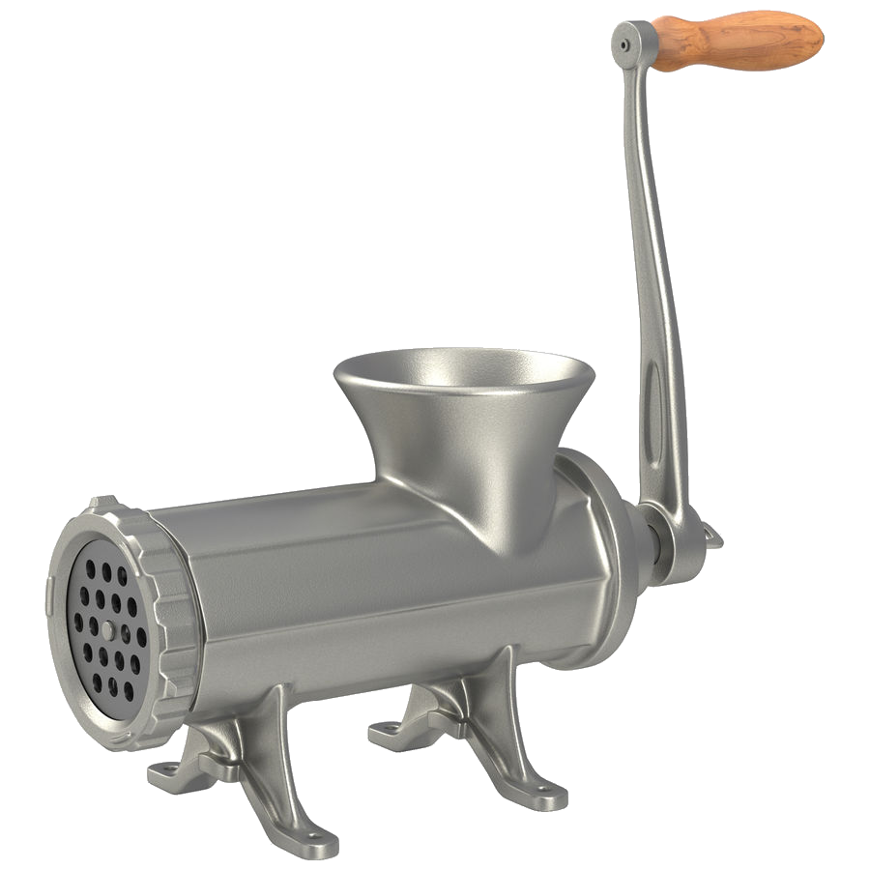
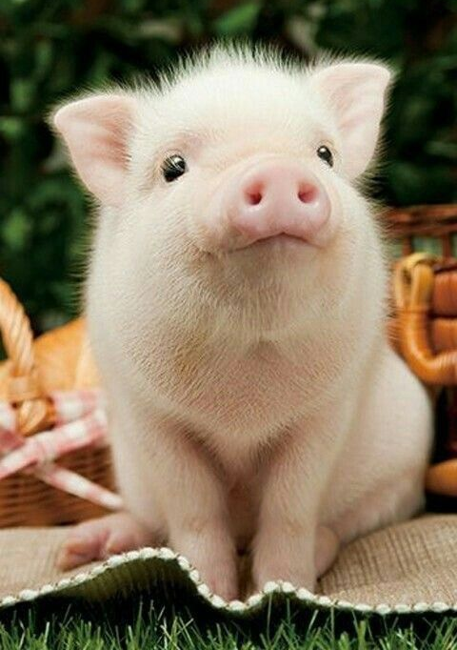

What we’ll be covering
variables
functions
data types

Slide 4

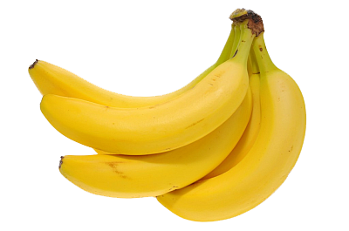
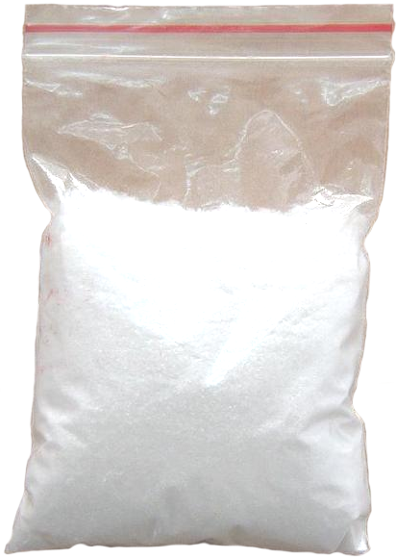
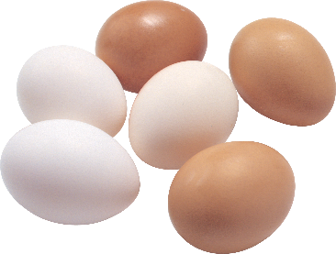



Variables
used to store information to be referenced and used by programs
Bananas
Butter
Flour
Eggs

Slide 5
Variables
declaration
name
data
my_variable = value

Slide 6



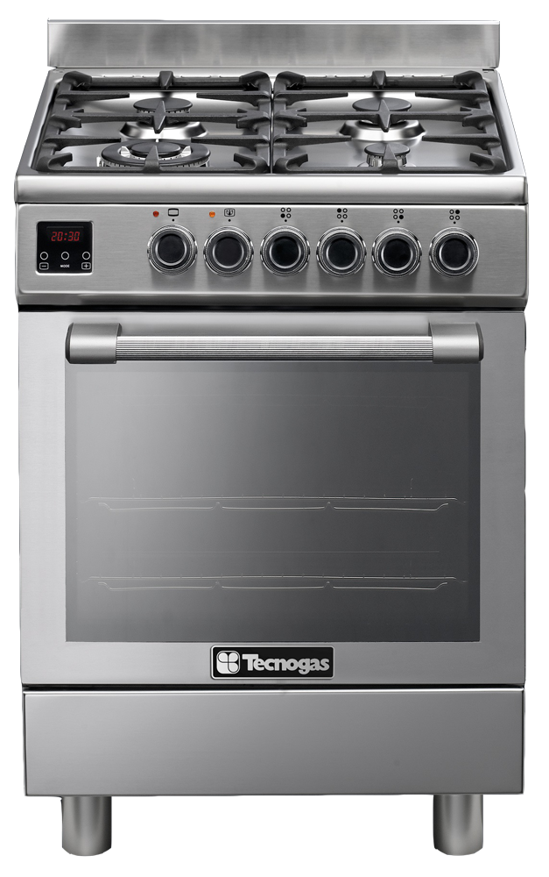

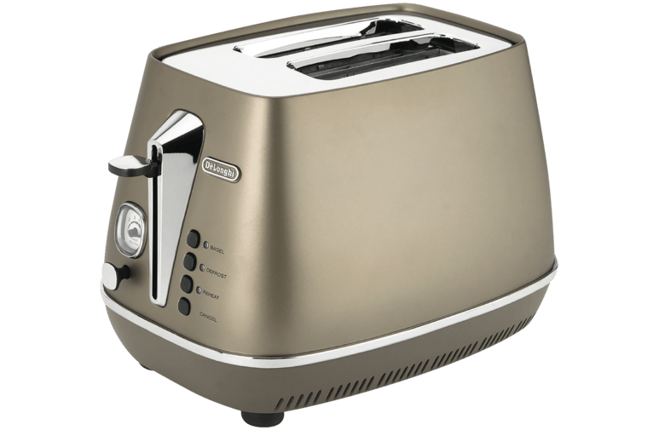
Functions
a named section of a program that performs a specific task
Module: Kitchen
Class: Oven
def_time = 20mins
def_temp = 200°C
Boil
Class
Timer
Bake
Masher
Whisk
Sieve
Class: Toaster

Slide 7
Functions
a named section of a program that performs a specific task
declaration
name
parameters
def my_function(input_a, input_b):
output = input_a + input_b
return output
process your inputs
return an output (optional)

Slide 8

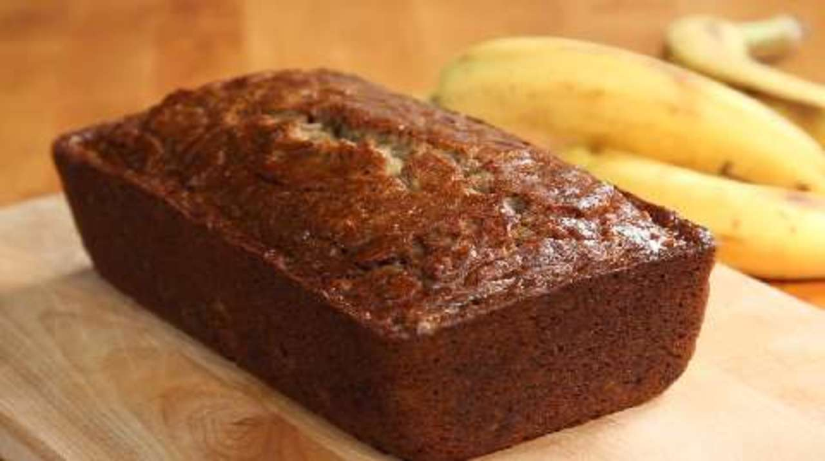
Program
A computer program is a collection of instructions that performs a specific task when executed by a computer.

Slide 9



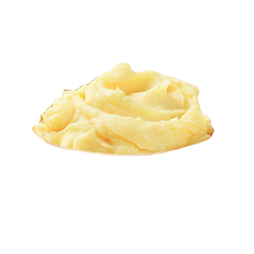


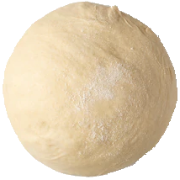







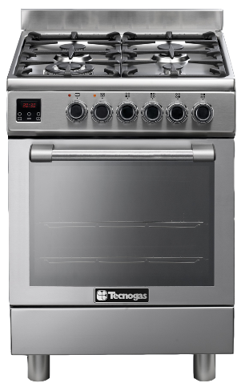

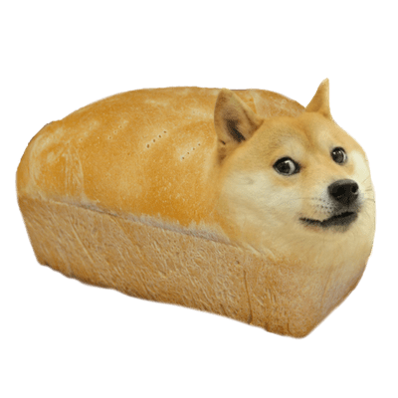








from kitchen import oven
from utensils import masher, whisk, wood_spoon
bananas =
butter =
flour =
eggs =
banana_mash = masher.mash(bananas)
melted_butter = oven.hob(butter)
fine_flour = sieve.sieve(flour)
banana_dough = wood_spoon.mix(eggs, banana_mash, melted_butter, fine_flour)
banana_bread = oven.bake(banana_dough, 40)
class oven:
def self():
self.def_time = 20
def bake(item, time):
while time < self.def_time:
cook item
return item
def boil(item, time):
while time < self.def_time:
boil item
return item

Slide 10

Any questions?

Slide 11
Rule 5. Data dominates. If you've chosen the right data structures and organized things well, the algorithms will almost always be self-evident. Data structures, not algorithms, are central to programming.
- Rob Pike's 5 Rules of Programming

Slide 12
Common data types
Data type
Example
Boolean
Integer
Float
String
List
Dictionary
Tuple
TRUE, FALSE
0, 99, 100, …
0.1, 1.00, 99.999999, …
“Banana”
[ TRUE, 99, 0.1, “Banana”, [“nested”] ]
{ “key”: “value”, “number”: 0, “n”: [] }
( TRUE, 99, 0.1, “Banana”, [“nested”] )

Slide 13
String
Characteristics
Useful in-built functions (methods)
Strings are denoted by quotes
“this is a string”
“anything”
“21”
“ “
capitalize()
title()
startswith()
endswith()
replace()

Slide 14
List
Characteristics
Useful in-built functions (methods)
Lists are one of several collections
[“string”, 21, True]
Lists are ordered
Lists items are accessed by an index
my_list = [‘a’, ‘b’, ‘c’]
my_list[0]
my_list[0:1]
my_list[:-1]
append()
insert()
remove()
reverse()
‘a’
[‘a’, ‘b’]
[‘c’]
0 1 2

Slide 15
Conditionals and Operators
Conditionals
Operators
if <condition>:
do this
elif <a different condition>:
do that
else:
do something else
in
not in
is
is not
x in y – True if x is a member of sequence y
True if x not in sequence y
x is y – True if x is equal to y
True if x not equal to y

Slide 16
Exercise
We’re going to:
Get a list of the 100 most popular names
Assign our name to a variable “my_name”
Define a function which checks if our name is in the popular names list
Call our function, passing in the necessary parameters
Fix any issues

Slide 17
Exercise
top_100_names = ["OLIVIA", "RUBY", "EMILY", "GRACE", "JESSICA", "CHLOE", "SOPHIE", "LILY", "AMELIA", "EVIE", "MIA", "ELLA", "CHARLOTTE", "LUCY", "MEGAN", "ELLIE", "ISABELLE", "ISABELLA", "HANNAH", "KATIE", "AVA", "HOLLY", "SUMMER", "MILLIE", "DAISY", "PHOEBE", "FREYA", "ABIGAIL", "POPPY", "ERIN", "EMMA", "MOLLY", "IMOGEN", "AMY", "JASMINE", "ISLA", "SCARLETT", "LEAH", "SOPHIA", "ELIZABETH", "EVA", "BROOKE", "MATILDA", "CAITLIN", "KEIRA", "ALICE", "LOLA", "LILLY", "AMBER", "ISABEL", "LAUREN", "GEORGIA", "GRACIE", "ELEANOR", "BETHANY", "MADISON", "AMELIE", "ISOBEL", "PAIGE", "LACEY", "SIENNA", "LIBBY", "MAISIE", "ANNA", "REBECCA", "ROSIE", "TIA", "LAYLA", "MAYA", "NIAMH", "ZARA", "SARAH", "LEXI", "MADDISON", "ALISHA", "SOFIA", "SKYE", "NICOLE", "LEXIE", "FAITH", "MARTHA", "HARRIET", "ZOE", "EVE", "JULIA", "AIMEE", "HOLLIE", "LYDIA", "EVELYN", "ALEXANDRA", "MARIA", "FRANCESCA", "TILLY", "FLORENCE", "ALICIA", "ABBIE", "EMILIA", "COURTNEY", "MARYAM", "ESME"]
my_name = ‘Olivia'
def my_function(my_name, list_of_names):
if my_name in list_of_names:
print(my_name + ' is in the list!')
else:
print(my_name + ' is not in the list')
if <condition>:
do this
else:
do that
<condition>
True if x in sequence y
my_function(my_name, top_100_names)

Slide 18
For loops
Using loops in computer programming allows us to automate and repeat similar tasks multiple times.
for <iterating variable> in <iterable sequence>:
<do something cool>
for name in ["OLIVIA", "RUBY", "EMILY",…]:
do something with name

Slide 19
Exercise
top_100_names = ["OLIVIA", "RUBY", "EMILY", "GRACE", "JESSICA", "CHLOE", "SOPHIE", "LILY", "AMELIA", "EVIE", "MIA", "ELLA", "CHARLOTTE", "LUCY", "MEGAN", "ELLIE", "ISABELLE", "ISABELLA", "HANNAH", "KATIE", "AVA", "HOLLY", "SUMMER", "MILLIE", "DAISY", "PHOEBE", "FREYA", "ABIGAIL", "POPPY", "ERIN", "EMMA", "MOLLY", "IMOGEN", "AMY", "JASMINE", "ISLA", "SCARLETT", "LEAH", "SOPHIA", "ELIZABETH", "EVA", "BROOKE", "MATILDA", "CAITLIN", "KEIRA", "ALICE", "LOLA", "LILLY", "AMBER", "ISABEL", "LAUREN", "GEORGIA", "GRACIE", "ELEANOR", "BETHANY", "MADISON", "AMELIE", "ISOBEL", "PAIGE", "LACEY", "SIENNA", "LIBBY", "MAISIE", "ANNA", "REBECCA", "ROSIE", "TIA", "LAYLA", "MAYA", "NIAMH", "ZARA", "SARAH", "LEXI", "MADDISON", "ALISHA", "SOFIA", "SKYE", "NICOLE", "LEXIE", "FAITH", "MARTHA", "HARRIET", "ZOE", "EVE", "JULIA", "AIMEE", "HOLLIE", "LYDIA", "EVELYN", "ALEXANDRA", "MARIA", "FRANCESCA", "TILLY", "FLORENCE", "ALICIA", "ABBIE", "EMILIA", "COURTNEY", "MARYAM", "ESME"]
my_name = ‘Olivia'
def my_function(my_name, list_of_names):
if my_name in list_of_names:
print(my_name + ' is in the list!')
else:
print(my_name + ' is not in the list')
lower_cased_names = []
for upper_case_name in top_100_names:
lower_cased_names.append( upper_case_name.title() )
lower_cased_names = [name.title() for name in top_100_names]
my_function(my_name, lower_cased_names)

Slide 20

The end! Thanks for coming!
Gary sent you a survey

